Slide 1
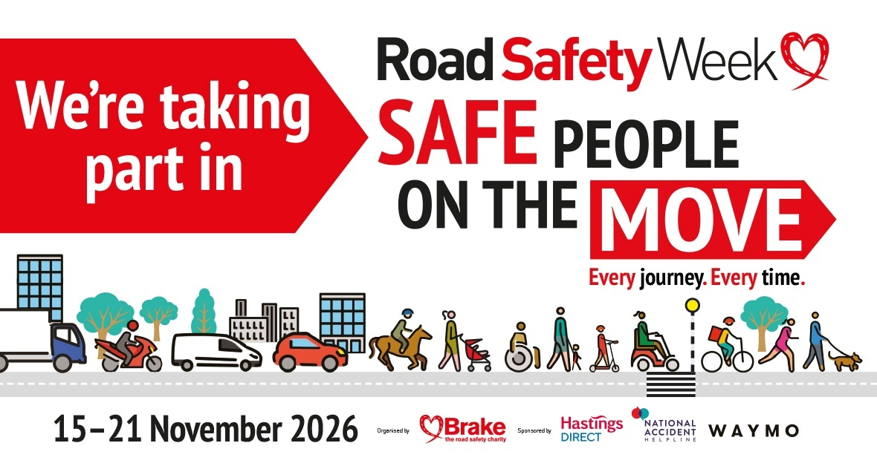
Notes:
Slide 1
This week, we are taking part in Road Safety Week.
Road Safety Week is a big road safety campaign that happens every year.
We’ll be talking about road safety this week because we all use roads in different ways, and it’s important that we can use roads safely to protect ourselves and other people.
A note about sensitivity
Discussions about road safety should be approached with care. If you are aware that a pupil has been affected by a road crash, either directly or indirectly, please talk to them and their parent or carer before involving them in any Road Safety Week activities. Please take individual needs into consideration when planning your activities and carry out risk assessments where required. The road safety animation explains that sometimes people get badly hurt in crashes and sometimes people die.
Move to next slide

Slide 2

Notes:
Slide 2
Every year, Road Safety Week has a different theme. This year, the theme is Safe People on the Move.
All children and young people use roads, and many have experienced road danger.
It’s never a nice fact to hear, but road crashes are the leading cause of death for children and young people worldwide, and seven children are killed or seriously injured on UK roads every day.
Whoever we are and however we travel, we all share our roads when we are on the move, and we all have the right to make safe and healthy journeys.
That’s why we’re going to be talking about being safe road users this week.
Being a safe road user protects us and other people, and helps to make sure everyone is safe on our roads.
Move to next slide

Slide 3
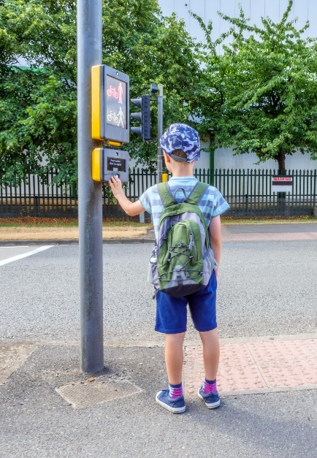
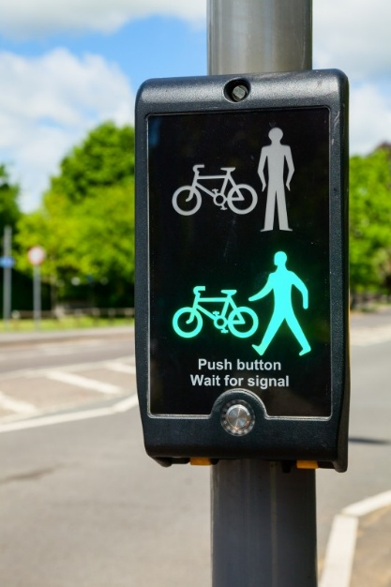
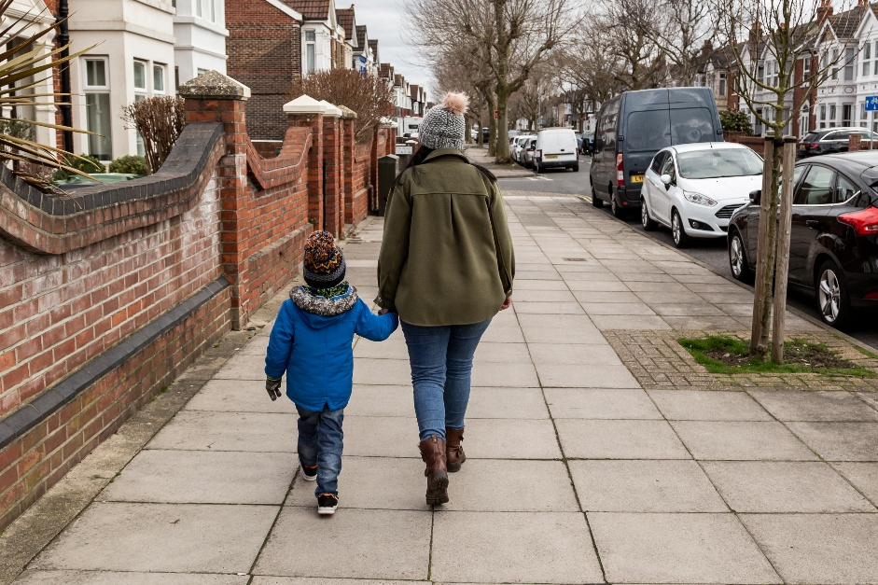
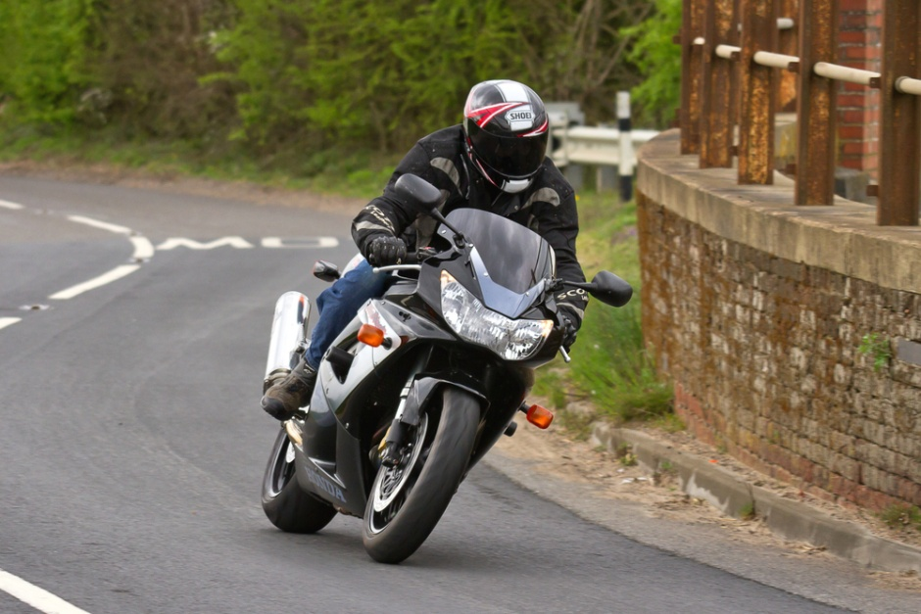
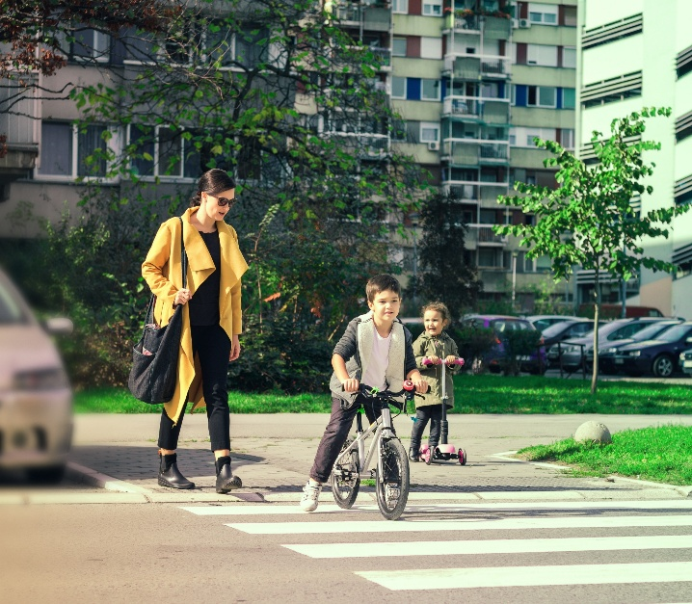
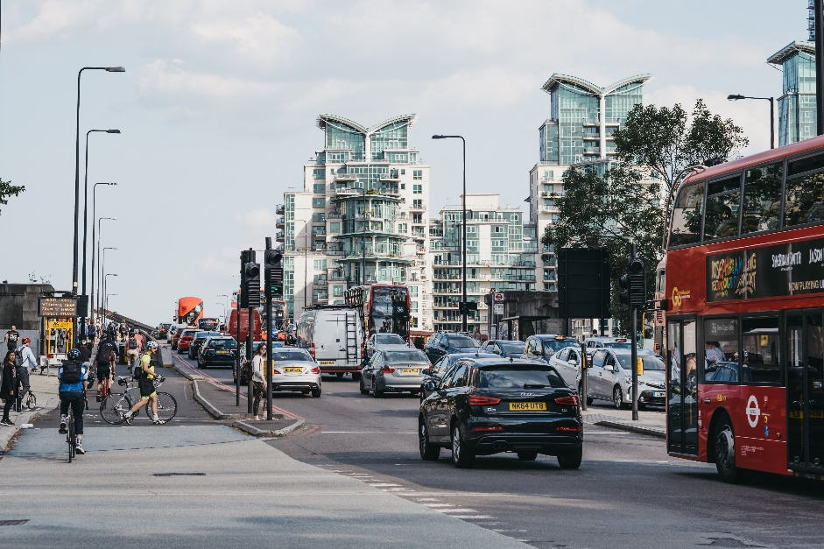
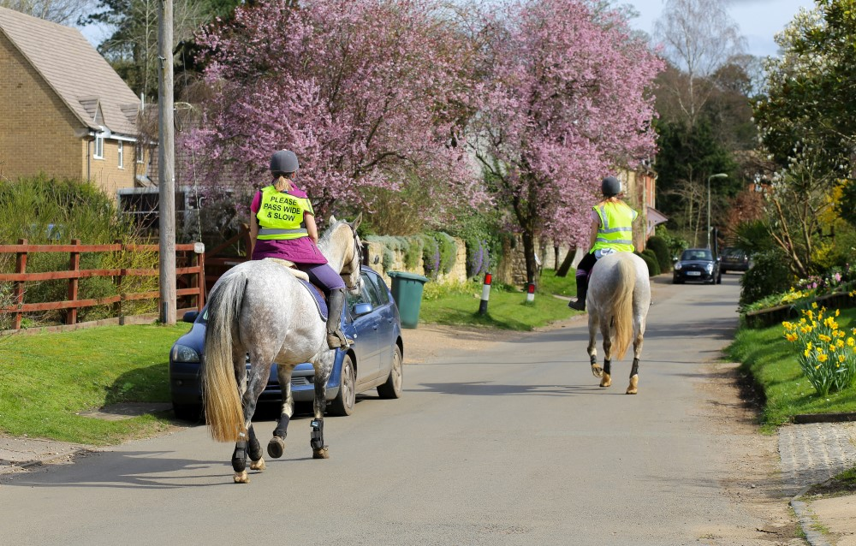

Notes:
Slide 3
How do we use roads?
Invite children to share how they travelled to school today. Their answers could include:
Walk or wheel
Cycle
Scoot
As a car passenger
As a bus or tram passenger
Ask them to talk about other road users they saw. Children may talk about:
People who walk or wheel – pedestrians
People who ride – bicycles, motorbikes, horses and scooters
People who use wheelchairs or mobility scooters
People who drive for work – buses, trams, ambulances, lorry drivers, van drivers
People who ride for work – food delivery, police
Children in pushchairs
Move to next slide

Slide 4
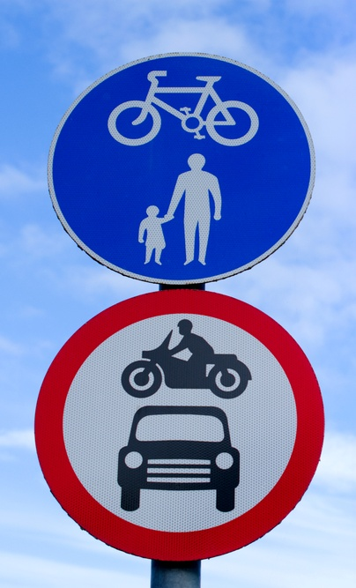
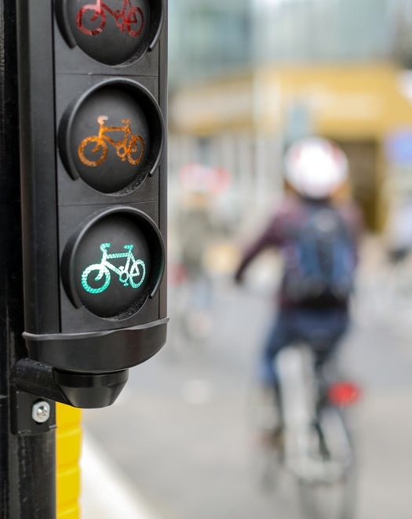
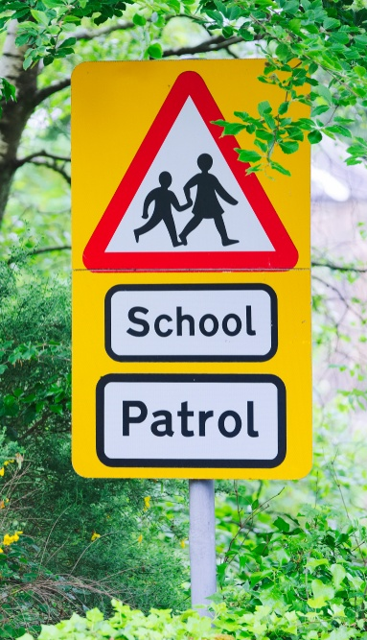
Notes:
Slide 4
We know that we share our roads with lots of different people.
Explain to children that, while it's not a nice fact to hear, every day children are hurt on roads. That's why it's important that we all use roads safely, to help keep ourself safe and protect other people.
Some people are in greater danger of being seriously hurt or even killed on roads.
This includes people who walk and wheel, and people who ride a bike, horse or motorbike.
People who drive are more likely to cause harm than people who walk, wheel or ride. This means they have greater responsibility to protect other road users.
Move to next slide

Slide 5
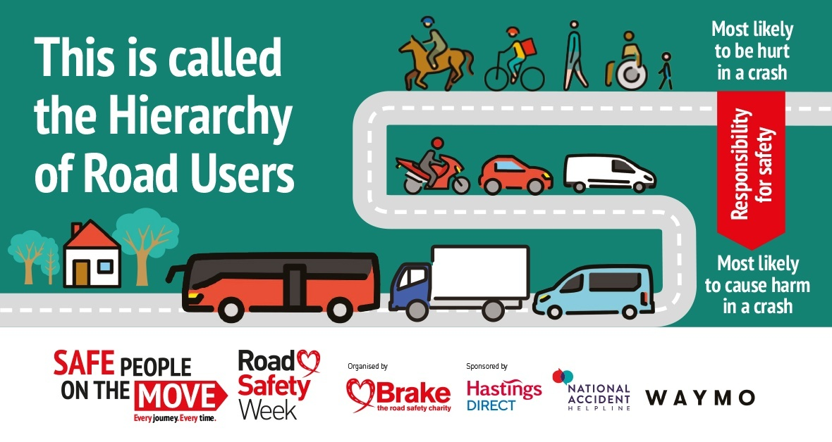
Notes:
Slide 5
There are rules we all need to follow when we use roads
Can you think of any rules?
Drive slowly near our school
Only cross the road when the green man shows
Stop when we see a red traffic light
No parking outside school
These rules are important to keep us safe.
Why do you think this is important?
Traffic is heavy and hard
If it hits us it can hurt us very badly
Our bodies are soft and get hurt easily
Big vehicles and fast traffic can cause the most harm.
There are rules that will help protect the people who need it most.
The rules say that the people who are most likely to be harmed in a crash need the most protection.
This includes pedestrians, cyclists, horse riders and motorcyclists. Children, older adults and disabled people are most at risk.
People who drive vehicles that cause the most harm need to take the greatest care to reduce the danger to others.
This means drivers of big vehicles like lorries and buses, vans and minibuses, and drivers of cars and taxis and motorbikes.
Cyclists and horse riders need to reduce danger to people who walk.
And everyone needs to use roads safely to protect themself and others.
Move to next slide

Slide 6
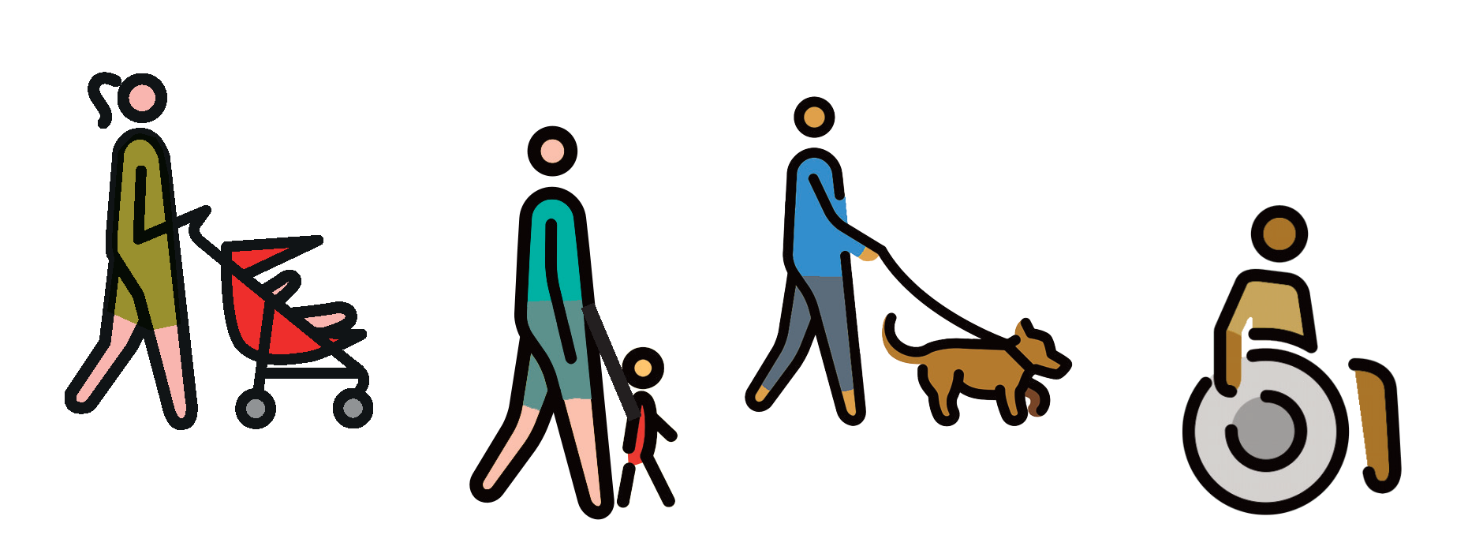
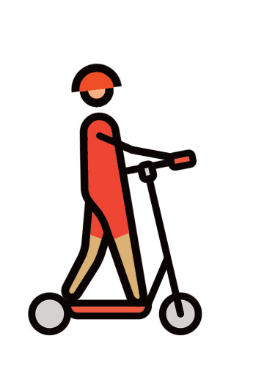
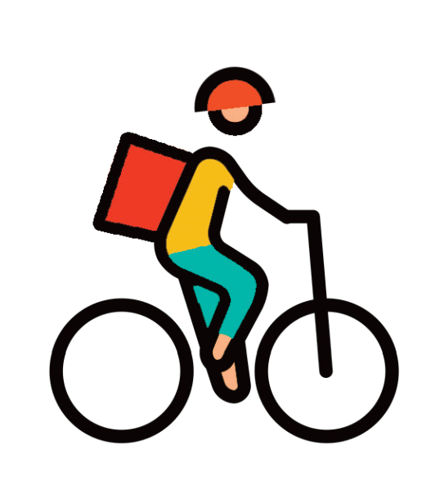
How can we be safe people on the move?
Notes:
Slide 6
How can we be safe people on the move?
We’re now going to show you how this works with a bit of help from [nominate class representatives or teachers to come to the front to show different types of road users]
Use whatever props you have available or big labels to represent someone who is:
Walking
Riding a scooter
Riding a bicycle
Riding a horse
Riding a motorbike
Driving a car
Driving a bus
Driving a lorry
Ask pupils who is most likely to do most harm:
Person driving a car
Person driving a bus
Person driving a lorry
Ask pupils who needs most protection:
Person walking
Person riding a bicycle
Person riding a horse
Person riding a motorbike
People who drive vehicles, especially big vehicles need to make sure they drive safely to protect people who walk and cycle and ride horses.
Remember, this week is Road Safety Week, and we’ll be talking about using roads safely.
Our grown ups can help us with this.
Remind young children that they should always hold hands with a grown-up when walking near roads. They should use safe footpaths away from traffic and always cross roads at safe places with a grown up. When riding their bikes, they should ride their bike with a grown up on a safe path away from traffic and wear a helmet to protect their head if they fall off. They should always sit in a special car seat to protect them when travelling by car.
Remind older children that we all share a responsibility to use roads safely, and this includes people who walk, wheel and ride, as well as people who drive. Say that they shouldn’t use their phone when walking near roads/crossing roads and they should play in safe places away from traffic. Children can talk to their parents or carers and remind them to drive at safe speeds, especially in areas where people live, work and play; to never use their phone while driving; and to always wear a seat belt.
Talk about any Road Safety Week activities that your school will be doing. There are resources to support all these activities in your Road Safety Week action pack.
Explain that the children will be learning a lot more about road safety throughout the week
Move to next slide

Slide 7
Notes:
Slide 7
Thank you and summary
Thank children for listening. Remind them that it is Road Safety Week and that they can all make a difference to road safety in their communities. They can be good role models, and use roads safely, and ask grown ups to help keep them safe near roads.
Remind them that they might be talking about road safety in other lessons this week.
END

