Slide 1
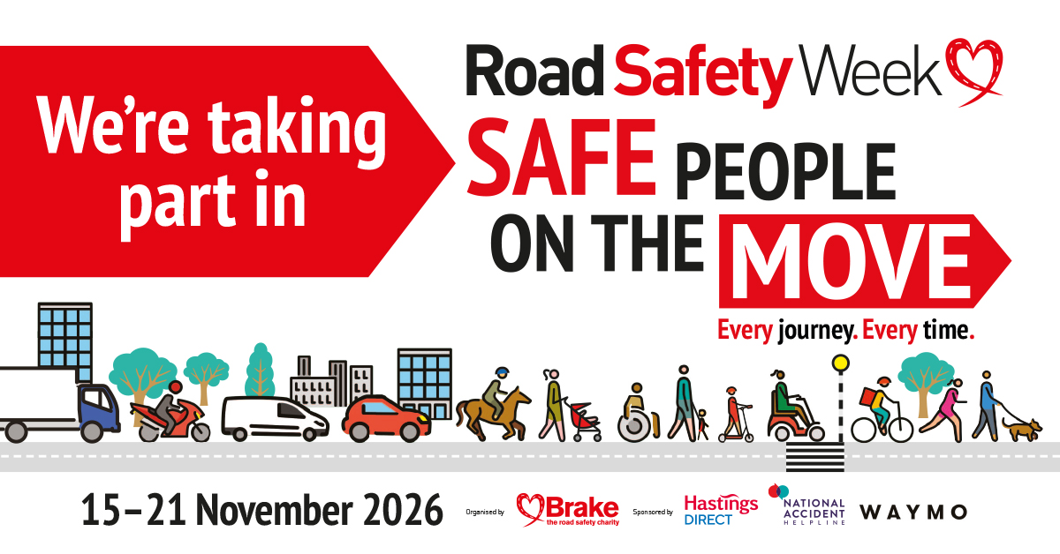
Notes:
Explain that you are taking part in Road Safety Week.
Taking place each November, Road Safety Week is a national campaign run by the charity Brake, to raise awareness of the devastating impact of road death and injury, and call for key measures to make roads safer.
This year’s Road Safety Week is all about people. It’s about the way we use our roads, and how we can all be safe when we’re on the move.
Explain that you are joining in to share the message that, whoever we are, and however we travel, we can all do something that will make a difference. We can all do something to protect ourselves and other people from harm, and make our roads safer for everyone.

Slide 2
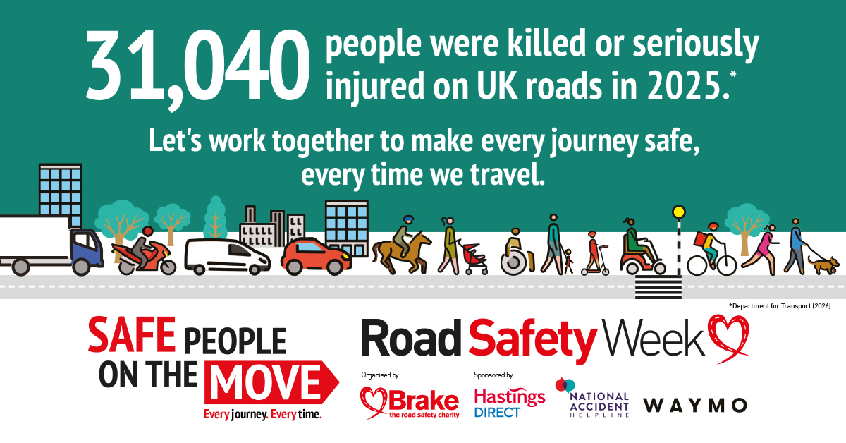
Notes:
Why is Road Safety Week important?
It’s never nice to hear, but five people die on UK roads every day*. Many more suffer serious, life-changing injuries leading to disability.
In 2025, 31,040 people were killed or seriously injured on UK roads.
These are not just numbers – behind every number is a grieving family, whose lives have changed beyond all recognition in an instant.
As an employer, we have a real responsibility to keep our staff safe, making sure everyone who drives for work can get home safely at the end of the day.
Driving is probably the most dangerous thing our employees do in their line of work, and it is estimated that around a quarter of UK road deaths and a fifth of serious injuries involve someone driving for work.
The good news is that we have the power to make a real difference, with robust policies and procedures to manage road risk.
This Road Safety Week, we are demonstrating how we put safety first and ensure our drivers are safe.

Slide 3
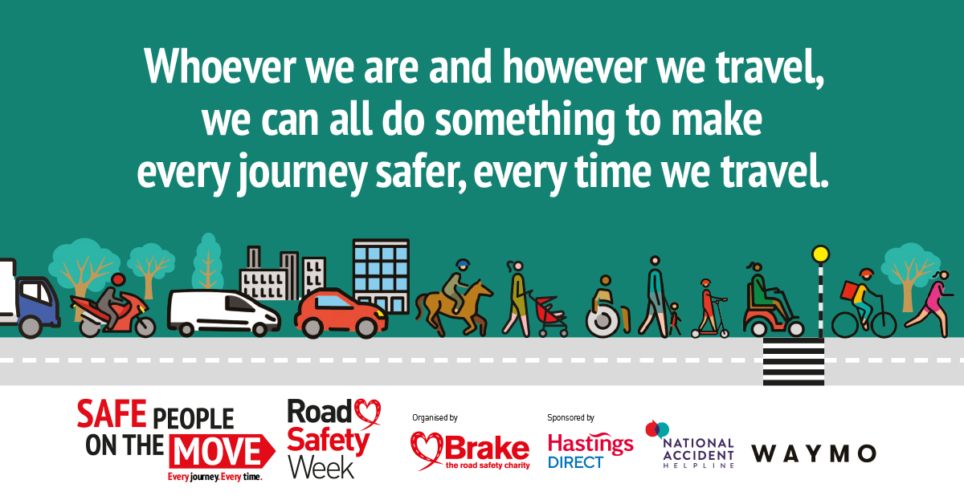
Notes:
About the theme of Road Safety Week: Safe People on the Move
Whether we walk or wheel, ride or drive, we all share our roads when we are on the move.
As safe road users, we can help protect ourselves and each other, so that everyone is safer on our roads. As safe road users we can:
Remember that the choices we make when we walk or wheel, ride or drive make a difference – and those choices can sometimes mean the difference between life and death.
Comply with road rules and share responsibility for the safety of everyone who uses roads.
Understand that those with the potential to do the most harm must take the greatest responsibility for safeguarding people who are more vulnerable on roads than them.
Safe road use is an important part of the safe system approach to road safety – a shared approach to prevent death and serious injury from road crashes.

Slide 4
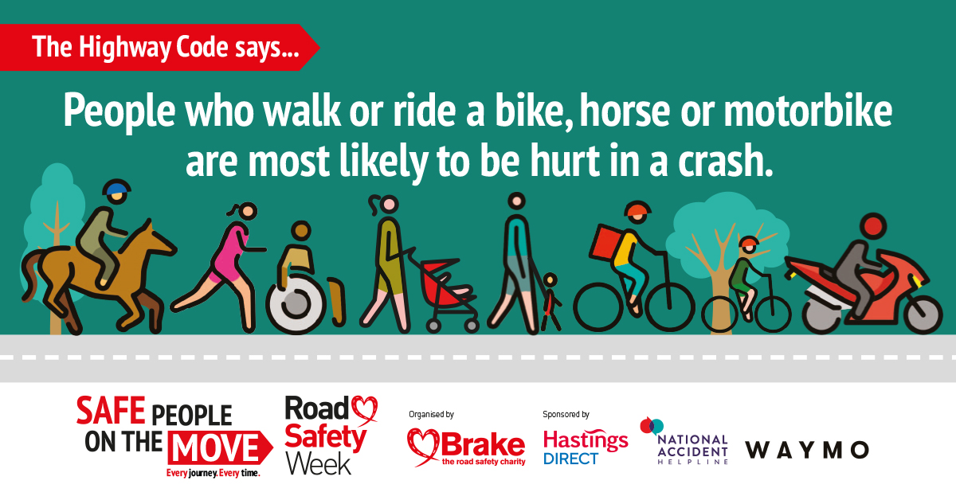
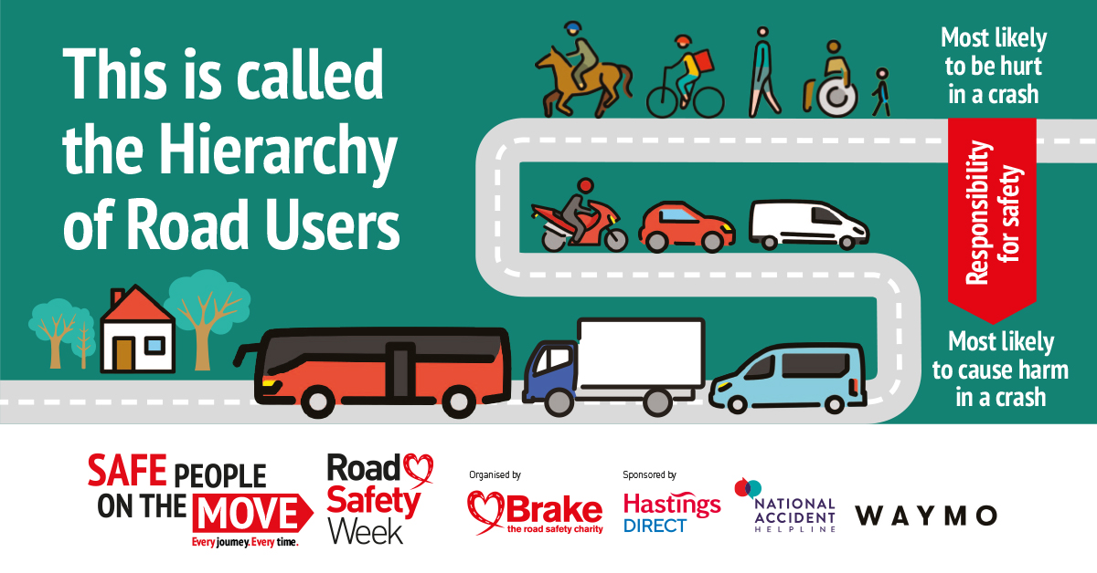
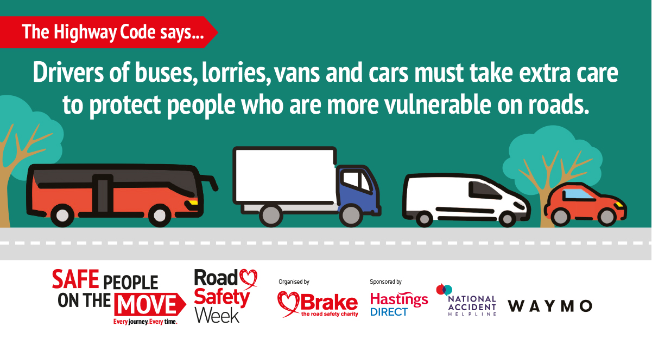
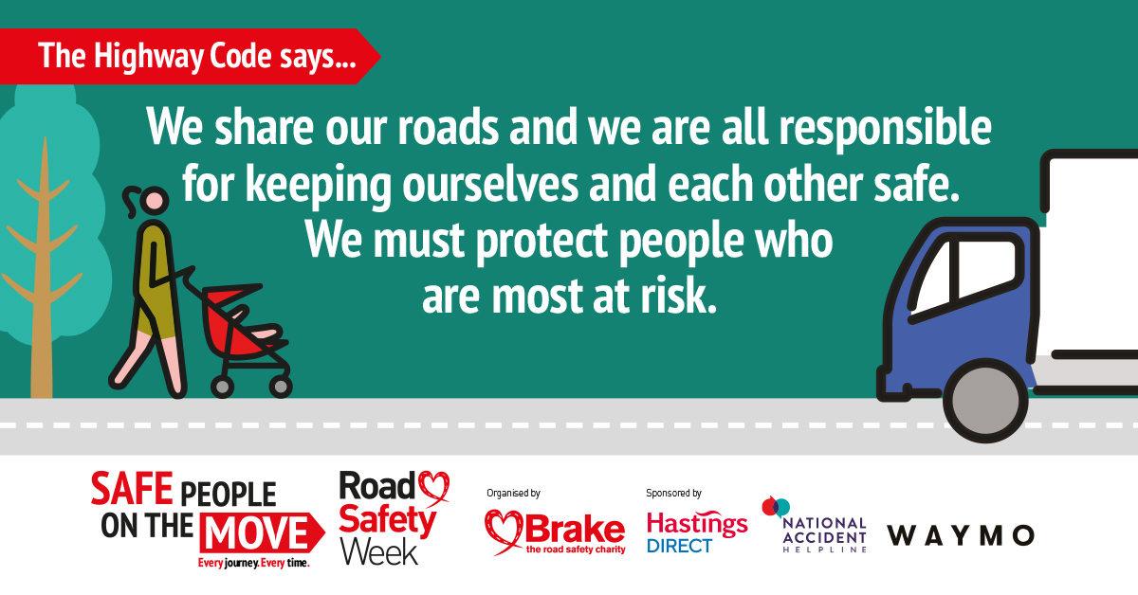
Notes:
The Highway Code
Use this slide to talk about rules in the Highway Code to protect vulnerable road users
The Highway Code says:
We share our road space and we are all responsible for keeping ourselves and each other safe.
People who walk or ride a bike, horse or motorbike are most likely to be hurt in a crash.
Drivers of buses, lorries, vans and cars are most likely to cause harm and must take extra care to protect people who are most at risk.
This is called the Hierarchy of Road Users.
You can also share the following statistics:
More than half of people killed or seriously injured on Britain’s roads in 2025 were pedestrians, motorcyclists or cyclists
Motorcyclists make up 20% of deaths and serious injuries
Pedestrians account for 21% of deaths and serious injuries
15% of people killed or seriously injured are pedal cyclists
Car occupants made up 38% of the numbers killed or seriously injured
At least one-quarter of crashes are thought to involve someone driving or riding for work.

Slide 5
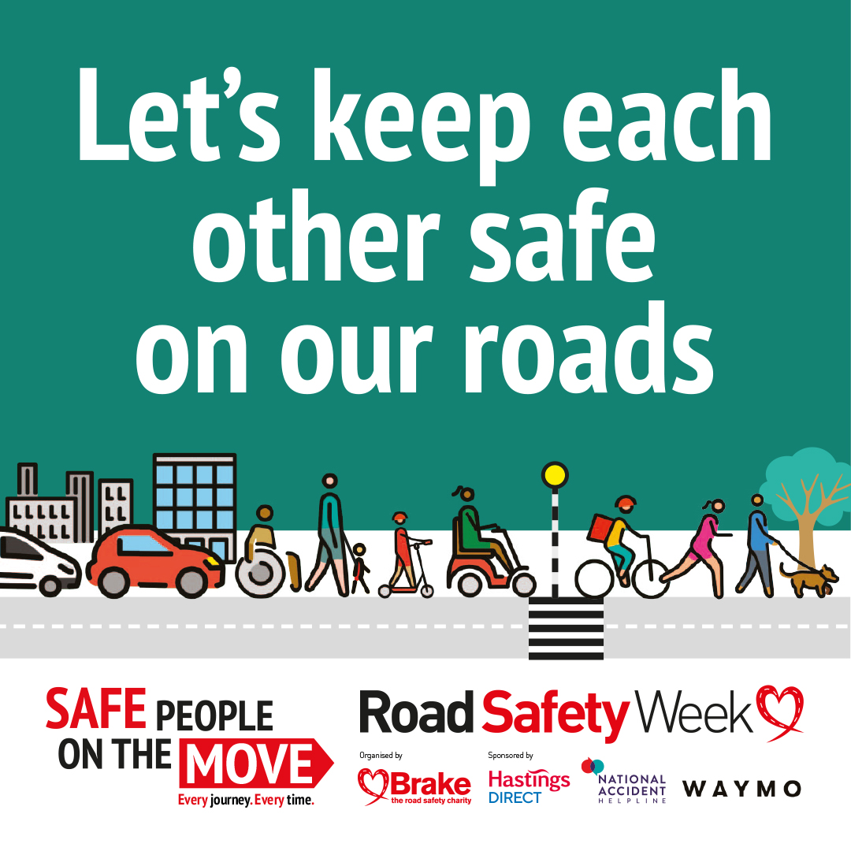
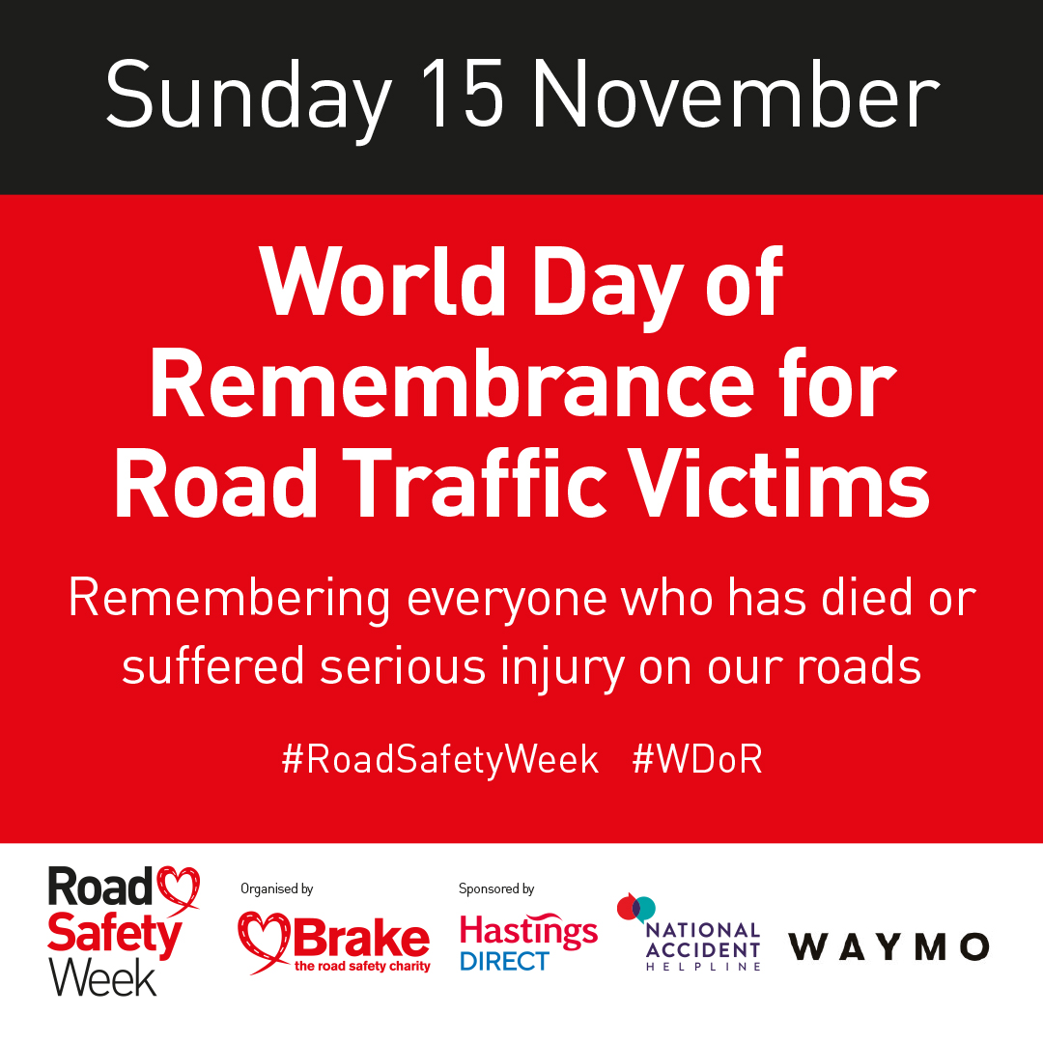
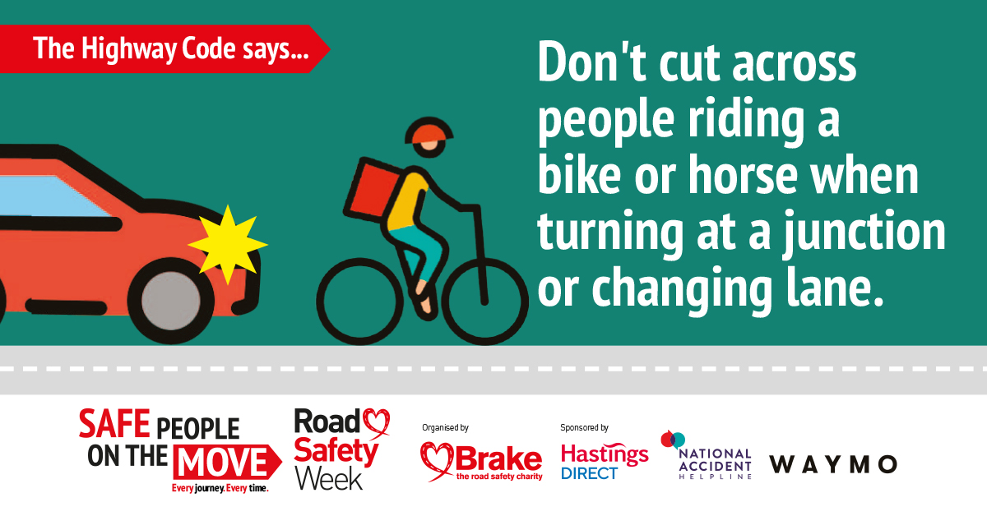
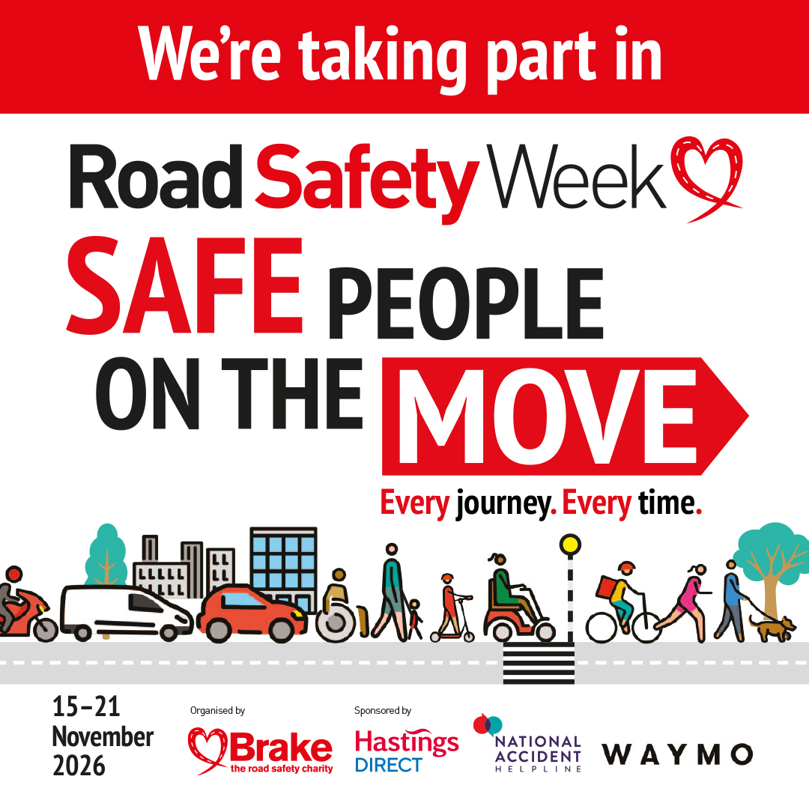
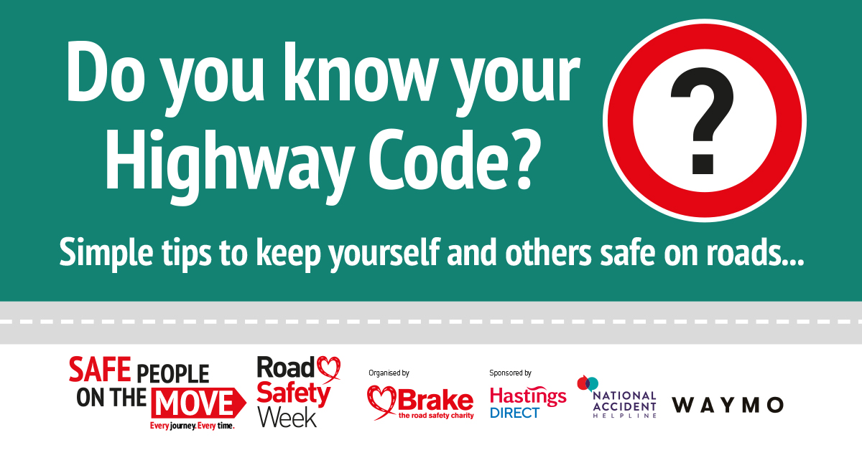
Notes:
Shouting out for Road Safety Week
Use this slide to explain some of the messages you will be sharing during Road Safety Week on social media.

Slide 6
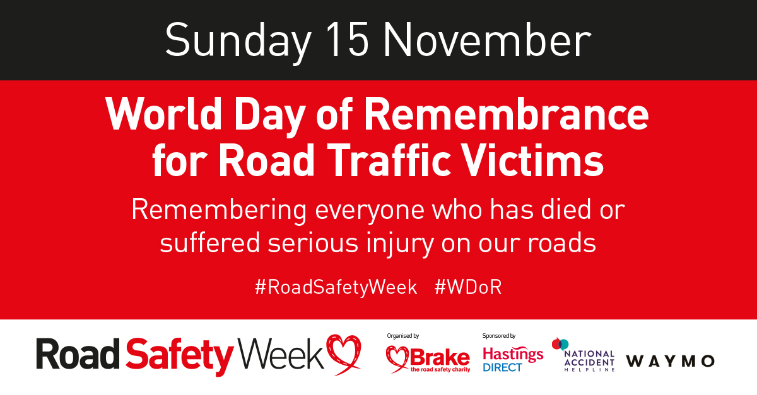
Notes:
If you are holding a memorial event for the World Day or Remembrance, you can use this slide to talk about this event.

Slide 7
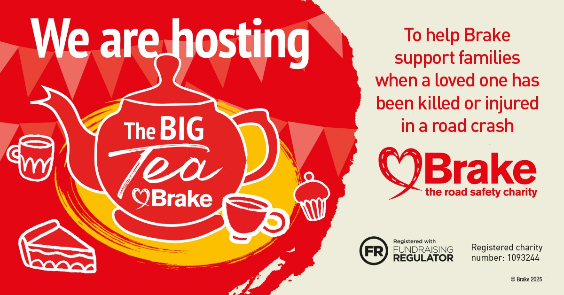
Notes:
If you are holding a Big Tea Brake to raise funds to support Brake, you can use this slide to talk about this event.

Slide 8
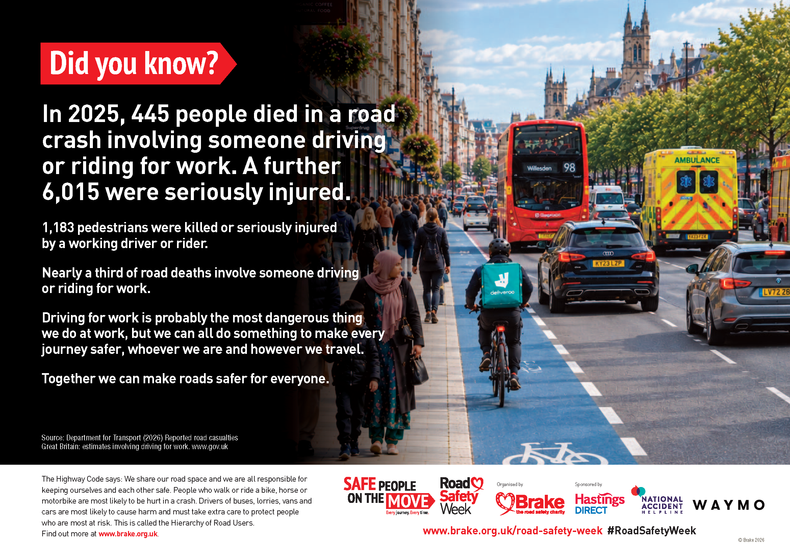
Notes:
Driving for work
Use this slide to highlight the risks associated with driving for work and the importance of using roads safely to protect everyone we share the road space with
In 2025, 445 people died in a road crash involving someone driving or riding for work. A further 6,015 were seriously injured.
1,183 pedestrians were killed or seriously injured by a working driver or rider.
Nearly a third of road deaths involve someone driving or riding for work.
Driving for work is probably the most dangerous thing we do at work, but we can all do something to make every
journey safer, whoever we are and however we travel.
Together we can make roads safer for everyone.
****
The Highway Code says: We share our road space and we are all responsible for keeping ourselves and each other safe. People who walk or ride a bike, horse or motorbike are most likely to be hurt in a crash. Drivers of buses, lorries, vans and cars are most likely to cause harm and must take extra care to protect people who are most at risk. This is called the Hierarchy of Road Users.

Slide 9
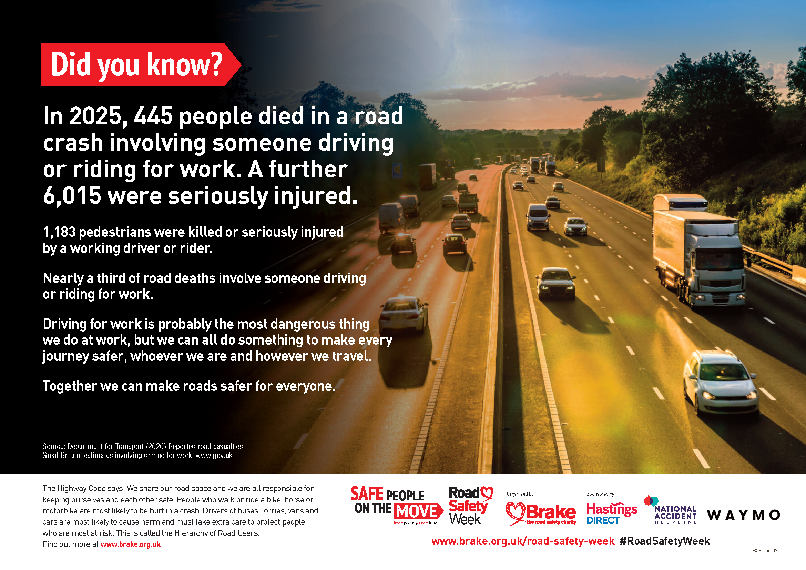
Notes:
Driving for work
Use this slide to highlight the risks associated with driving for work and the importance of using roads safely to protect everyone we share the road space with
In 2025, 445 people died in a road crash involving someone driving or riding for work. A further 6,015 were seriously injured.
1,183 pedestrians were killed or seriously injured by a working driver or rider.
Nearly a third of road deaths involve someone driving or riding for work.
Driving for work is probably the most dangerous thing we do at work, but we can all do something to make every
journey safer, whoever we are and however we travel.
Together we can make roads safer for everyone.
****
The Highway Code says: We share our road space and we are all responsible for keeping ourselves and each other safe. People who walk or ride a bike, horse or motorbike are most likely to be hurt in a crash. Drivers of buses, lorries, vans and cars are most likely to cause harm and must take extra care to protect people who are most at risk. This is called the Hierarchy of Road Users.

Slide 10
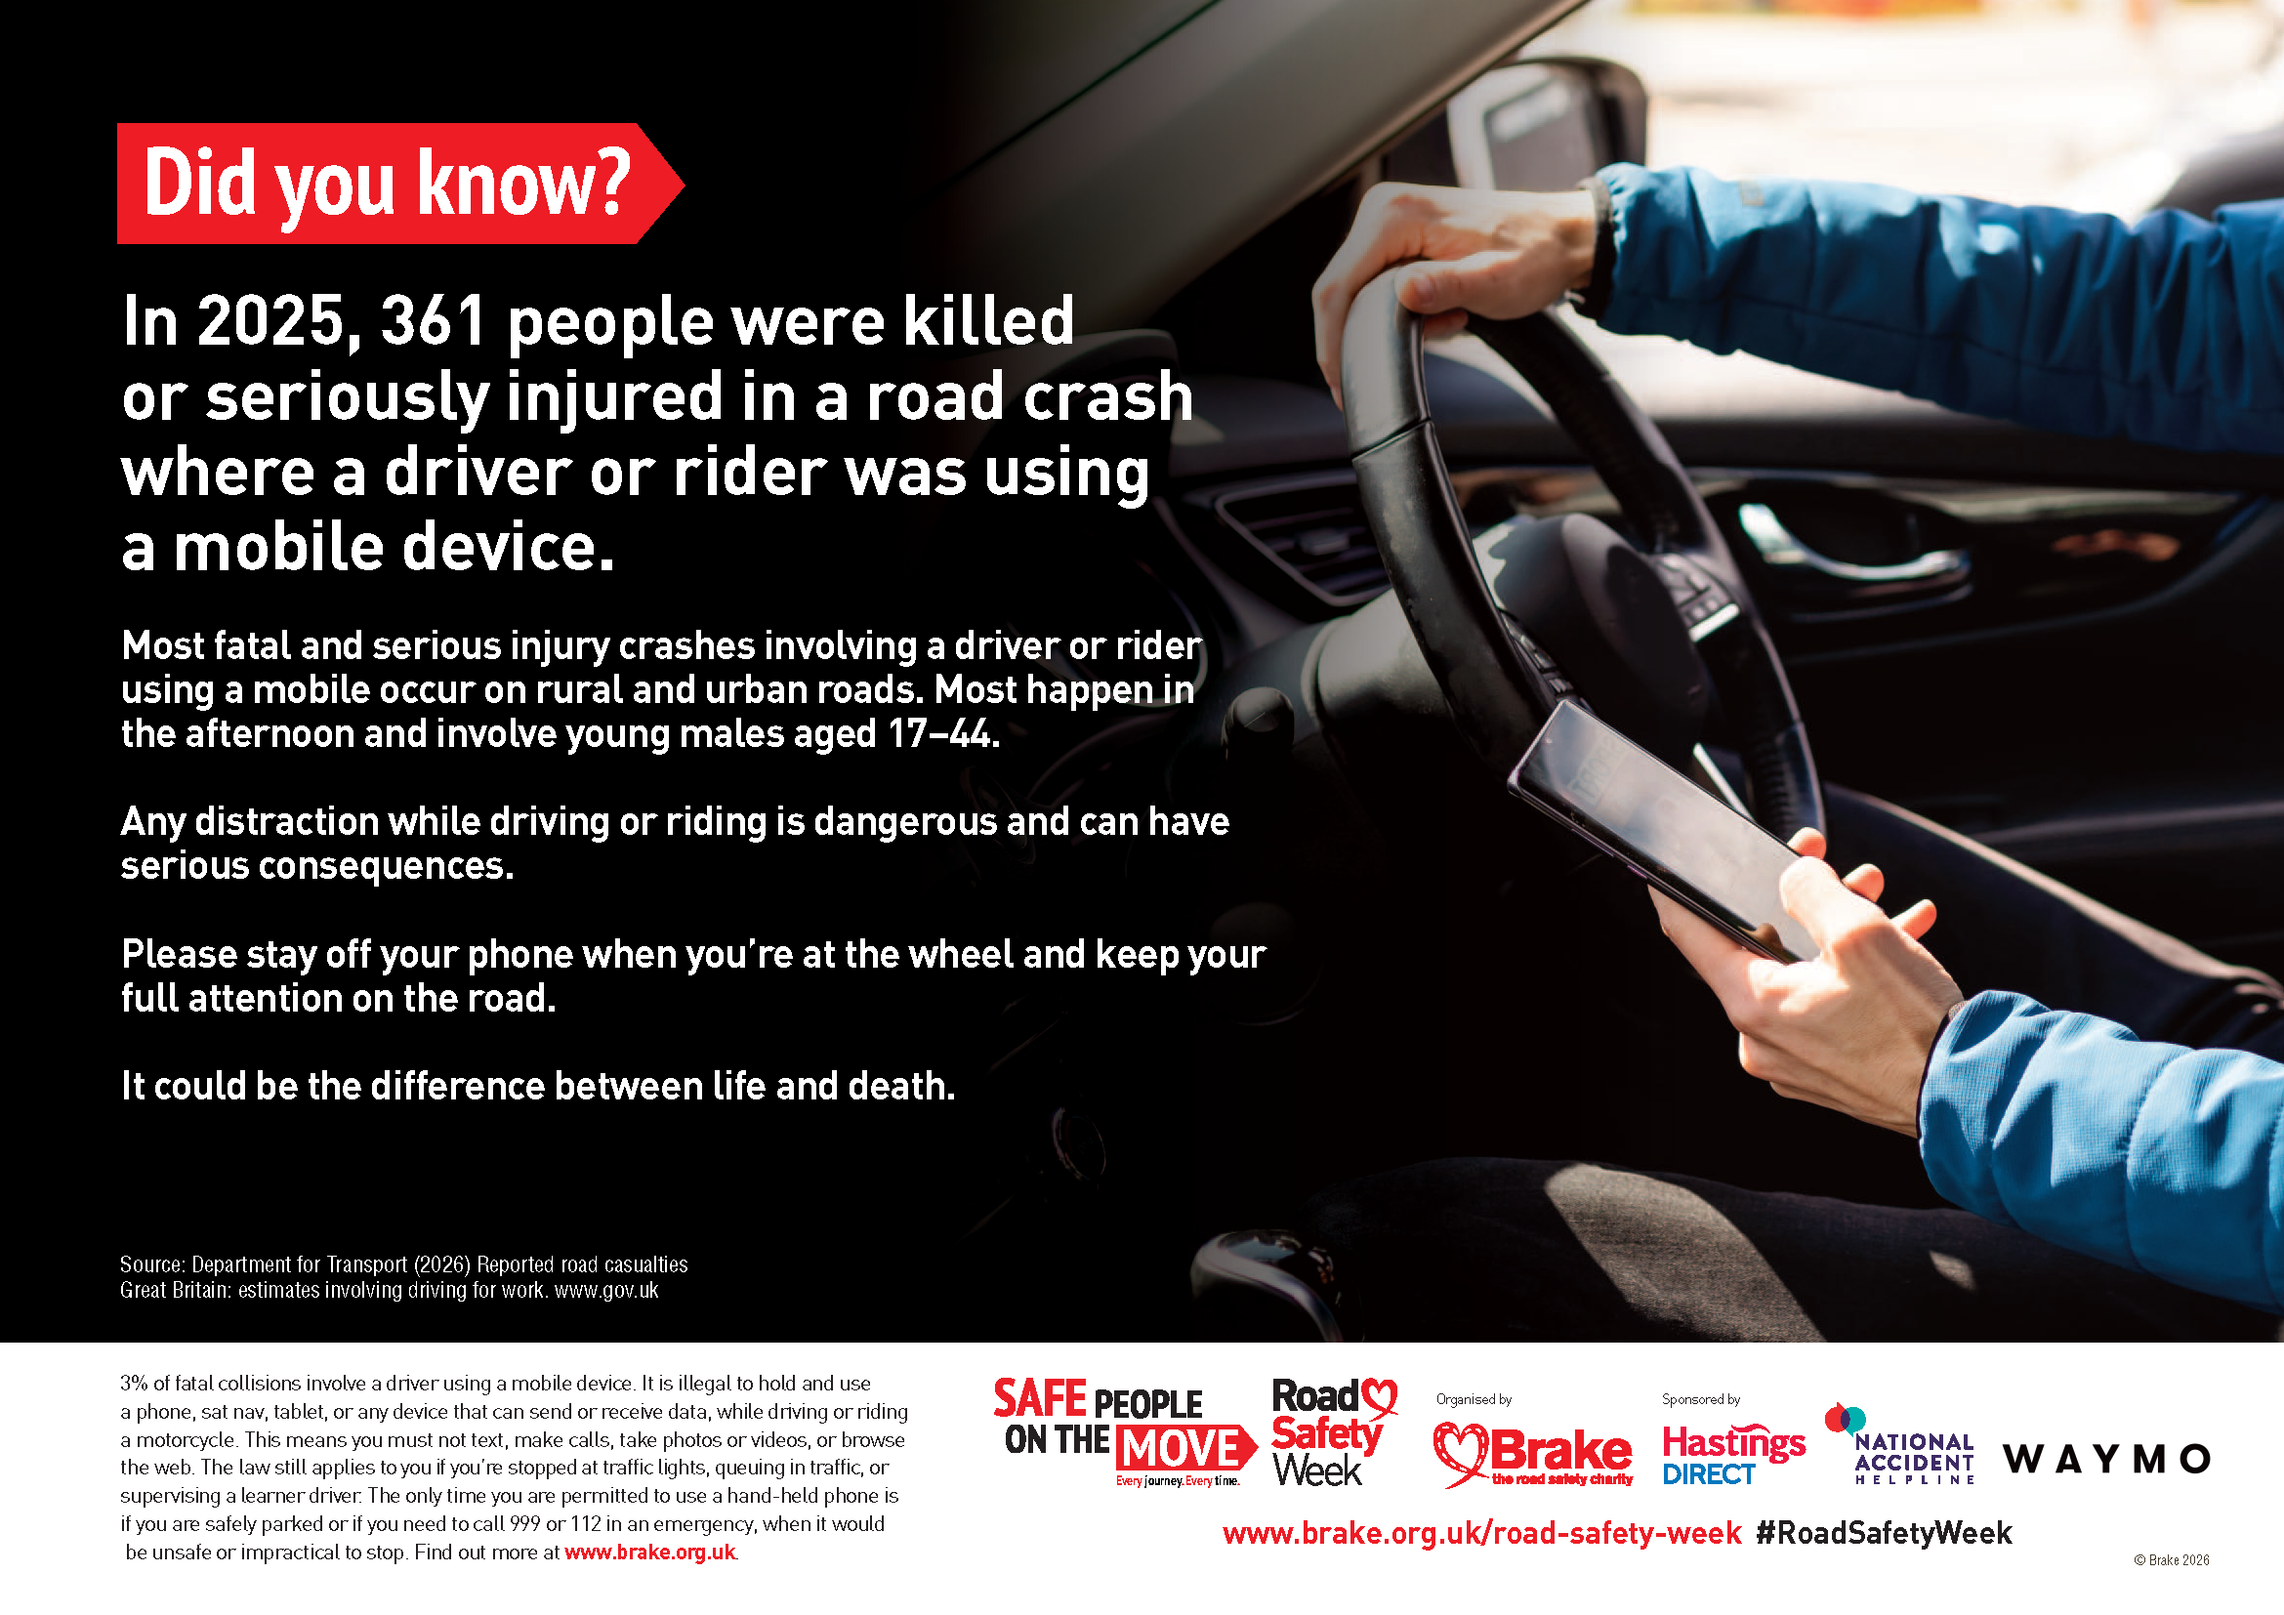
Notes:
Driver distraction
Use this slide to highlight the risks associated with driver distraction
In 2025, 361 people were killed or seriously injured in a road crash where a driver or rider was using a mobile device.
Most fatal and serious injury crashes involving a driver or rider using a mobile occur on rural and urban roads. Most happen in the afternoon and involve young males aged 17–44.
Any distraction while driving or riding is dangerous and can have serious consequences.
Please stay off your phone when you’re at the wheel and keep your full attention on the road.
It could be the difference between life and death.
3% of fatal collisions involve a driver using a mobile device.
It is illegal to hold and use a phone, sat nav, tablet, or any device that can send or receive data, while driving or riding a motorcycle.
This means you must not text, make calls, take photos or videos, or browse the web.
The law still applies to you if you’re stopped at traffic lights, queuing in traffic, or supervising a learner driver.
The only time you are permitted to use a hand-held phone is if you are safely parked or if you need to call 999 or 112 in an emergency, when it would be unsafe or impractical to stop.

Slide 11
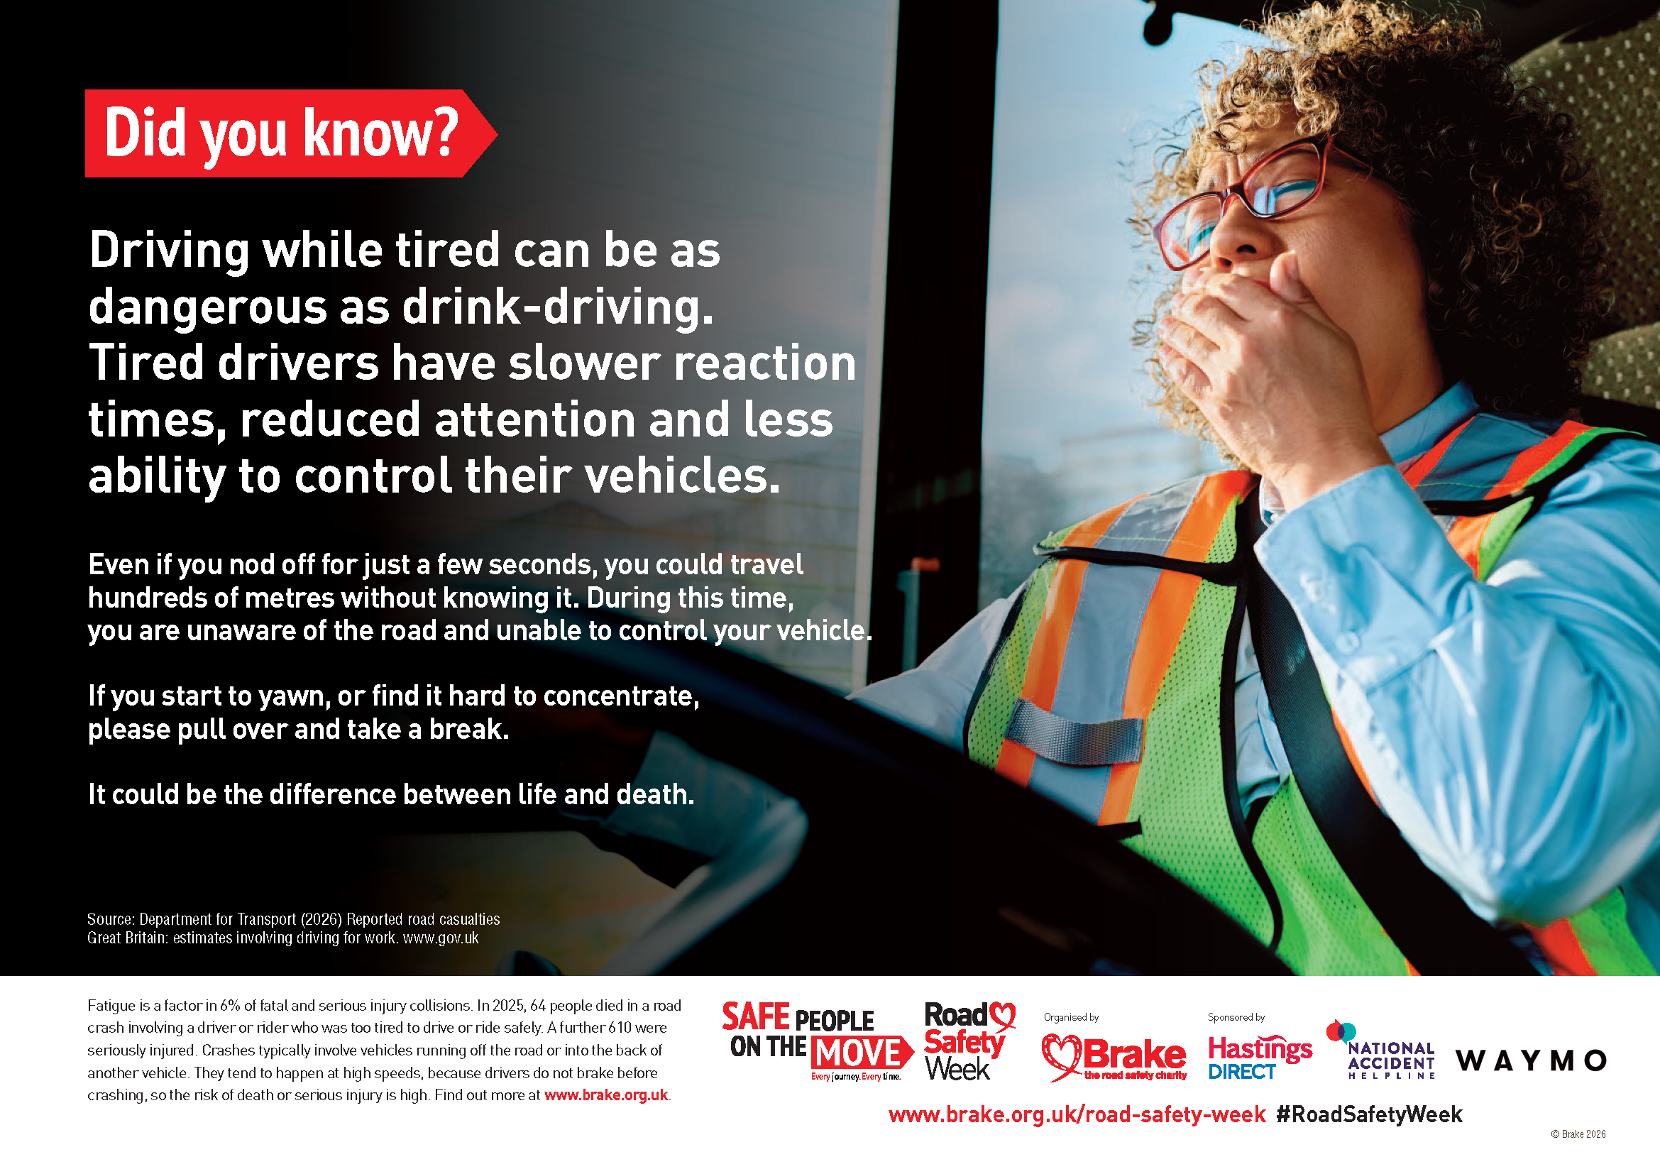
Notes:
Driver fatigue
Use this slide to highlight the risks associated with driver fatigue
Driving while tired can be as dangerous as drink-driving.
Tired drivers have slower reaction times, reduced attention and less ability to control their vehicles.
Even if you nod off for just a few seconds, you could travel hundreds of metres without knowing it. During this time, you are unaware of the road and unable to control your vehicle.
If you start to yawn, or find it hard to concentrate, please pull over and take a break.
It could be the difference between life and death.
Fatigue is a factor in 6% of fatal and serious injury collisions.
In 2025, 64 people died in a road crash involving a driver or rider who was too tired to drive or ride safely. A further 610 were seriously injured.
Crashes typically involve vehicles running off the road or into the back of another vehicle. They tend to happen at high speeds, because drivers do not brake before crashing, so the risk of death or serious injury is high.

Slide 12

Notes:
Add additional slides as required to talk about your own events and activities during Road Safety Week

Slide 13
Notes:
Add additional slides as required to talk about your own events and activities during Road Safety Week

Slide 14
Notes:
Add additional slides as required to talk about your own events and activities during Road Safety Week

Slide 15
